Slide 1

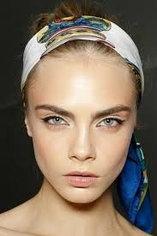
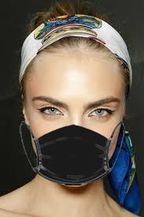
Masks Detection

Slide 2
Methdology of mask detection
Detect if face exists ?
Detect if mask exists ?
Show

Slide 3
Model
Pretrained face detection model + binary classifier (MOBILENETV2)
=
mask detection

Slide 4
Requirements
Anaconda prompt
Python 3.7
Tensorflow , opencv, numpy , dlip

Slide 5

